Slide 1
Plasmonic lens for avalanche photodiode
Flavio Nucciarelli
PhD student
SGENIA & Universidad Autónoma de Madrid
22nd September 2015

Slide 2
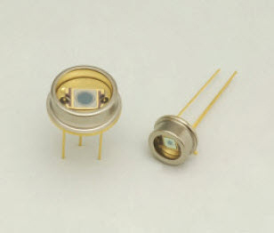
Improving collection efficency APD device
3 – 4 mm
SPP LENS
20 μm
150 μm
APD
2 mm
150 μm
APD

Slide 3
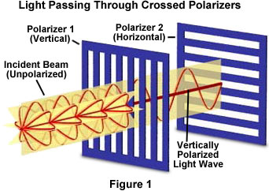
Benefits in using Plasmonic lens in SPADs
High numerical aperture (NA) at a specific λ
Increasing sensor detection area without noise increase
Processability and integration are simplified compared to optical lenses
Acting on polarization and phase of the incident wave
M
E
T
A
L
E
N
S
x 10-100
APD

Slide 4
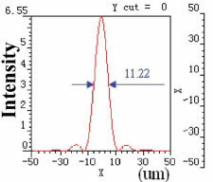
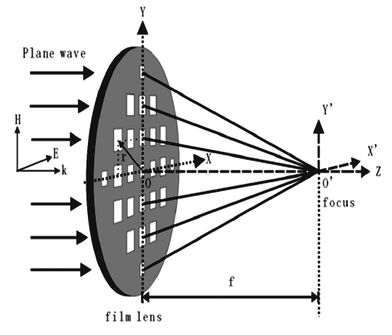
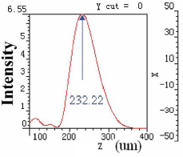
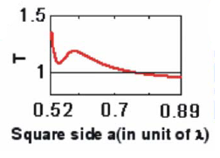
Hole array lens
Key features
f focal length
r lens radius
L hole arrays period
a hole dimension
t thickness
Die dielectric material
Me metal material
Example structure: r =140 μm and
t= 19,08 μm @ λ=10.6 μm

